Slide 1
Teach Ex Erasmus +
Eureka Centre, CIRTL, UCC
Feb 8 -10, 2016
Active Learning: Theoretical Perspectives

Slide 2
UCC Context
The motto of the Centre for the Integration of Research, Teaching and Learning
“Where Finbarr Taught Let Munster learn”.

Slide 3
CIRTL at the The West Lodge

Slide 4
www.doiit.gmu.edu/inventio/randybass.htm
“In scholarship and research having a problem is at the heart of the investigative process…But in one’s teaching a ‘problem’ is something you don’t want to have and if you have one, you probably want to ‘fix’ it. Changing the status of the problem in teaching from terminal remediation to ongoing investigation is precisely what the movement for the scholarship of teaching is all about”.

Slide 5
A New Challenge
Ernest Boyer’s 4 Scholarships of the University
The scholarship of Discovery
The scholarship of Integration
The scholarship of Application
The Scholarship of Teaching
(Ernest Boyer Scholarship Reconsidered, 1990)

Slide 6
Scholarship and Teaching
For an activity to be designated as scholarship, the American Association for Higher Education suggests that three characteristics are needed:
It should be public
It should be susceptible to critical review and evaluation
It should be accessible for exchange and use by other members of one’s community
(Lee Shulman, in P. Hutchings The Course Portfolio 1998)

Slide 7
“Where Finbarr Taught Let Munster Learn”

Slide 8
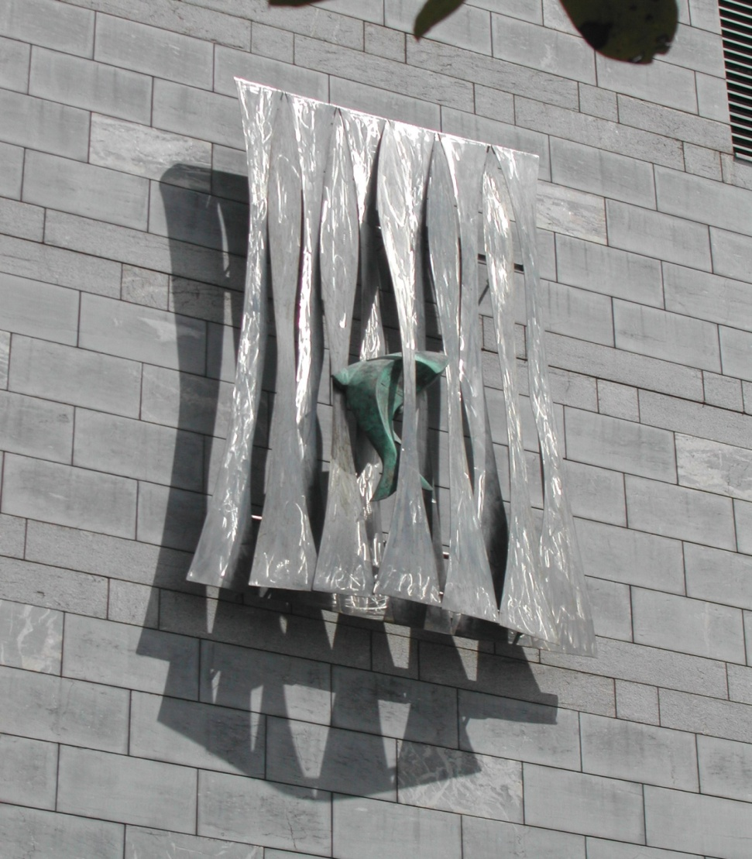
Fantailed on the Falls: (Fallon) Salmon of Knowledge / Breadán Feasa

Slide 9
The Seekers

Slide 10
The Boole

Slide 11
The West Wing

Slide 12
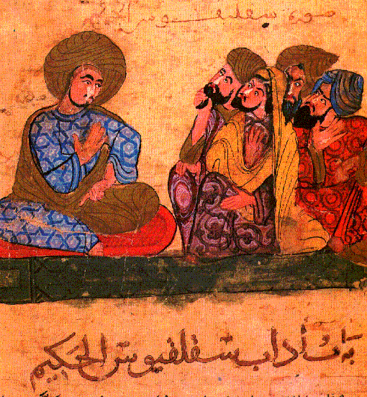
Socrates (Greek philosopher) depicted as a teacher from a medieval manuscript

Slide 13
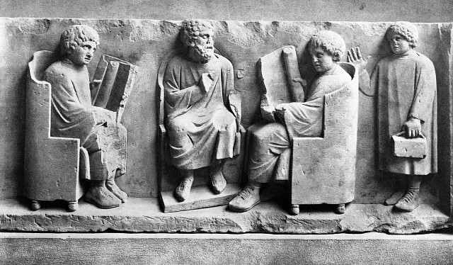
Relief with a scene from a Roman School

Slide 14
Teaching and Learning in China

Slide 15
Kornhaber, 1997, Intelligence: Multiple Perspectives
“Notions about intelligence vary over time, across cultures and even within cultures. Definitions of intelligence depend on whom you ask, their methods and levels of study, and their values and beliefs. Definitions are associated with the needs and purposes of different cultures”.
Note, for example, the different words in the Irish language for intelligence (éirimiúil; cliste; glic; críonna; stuama; tuisceanach; intleachtúil).

Slide 16
Intelligence in different cultures (from Kornhaber, 1997)
Industrialised North Americans tend to associate intelligence with speedy answers
Rural members of the Baganda tribe in Uganda think of intelligence as slow, careful, active, straight forward, sane
In the Mashona tribe in Zimbabwe, the intelligent person exercises prudence and caution especially in social interaction
For the Kipsigis of Kenya their word for intelligence includes social responsibility

Slide 17
Gardner: observation 1
“The daily opportunity to work with children and with brain damaged adults impressed me with one brute fact of human nature:
People have a wide range of capacities. A person’s strength in one area of performance simply does not predict any comparable strengths in other areas” (1999, 31).

Slide 18
Gardner: observation 2
“In most cases, strengths are distributed in a skewed fashion…a person may be skilled in foreign languages, yet be unable to find her way around an unfamiliar environment or to learn a new song
Likewise, weakness in learning foreign languages does not predict either success or failure with most other cognitive tasks” ( 1999, 31).

Slide 19
Gardner’s conclusion:
“The human mind is better thought of as a series of relatively separate faculties, with only loose and non-predictable relations with one another, than a single, all purpose machine that performs steadily at a certain horsepower, independent of content and context” (1999, 32).

Slide 20
Howard Gardner’s Theory of Multiple Intelligences
Gardner originally (Frames of Mind, 1983) offered the following definition of intelligence:
“the ability to solve problems or to create products that are valued within one or more cultural settings”.
In his 1999 book Intelligence Reframed - Multiple Intelligences for the 21st Century, Gardner refines the definition as follows:
“a biopsychological potential to process information that can be activated in a cultural setting to solve problems or create products that are of value in a culture”

Slide 21
Howard Gardner’s Theory of Multiple Intelligences
Individuals are never endowed solely with one intelligence. Rather, all brain-unimpaired people possess all the intelligences, which they blend in various ways in the course of creating something that is meaningful or performing a meaningful role or task.

Slide 22
Multiple Intelligences

Slide 23
MI-key features
based on real- world intelligence
pluralistic view of intelligence
all intelligences are universal
intelligences are educable
unique profiles of, that develop & change
each involves sub-abilities/manifestations
they work in combination, not isolation

Slide 24
The Developing Mind : Vygotskian influence
Vygotsky spoke of learning inter-linked to development
Development comes through maturation but learning depends on good teaching
We must consider the reciprocity of
Teaching
Assessment/Feedback
Learning

Slide 26
The Dimensions of Disciplinary Understanding
Knowledge: ( What ?)
What questions do experts ask?
What do they need to know about?
Methods: (How?)
How do experts find out?
Purposes (Why?)
Why do they do what they do? What is the goal?
How do experts use what they know?
Forms (How Expressed?)
How do experts communicate?
What are the tools of the discipline?
Notes:
26

Slide 27
Active Learning : Problematising Teaching
Teaching as Research/Investigation
Bass: the movement in teaching is from remediation to investigation
Documenting our teaching – naming its parts: – teaching spaces and learning spaces
Making teaching and learning visible: making assessment transparent
Teaching as learning – mind the gap!

Slide 28
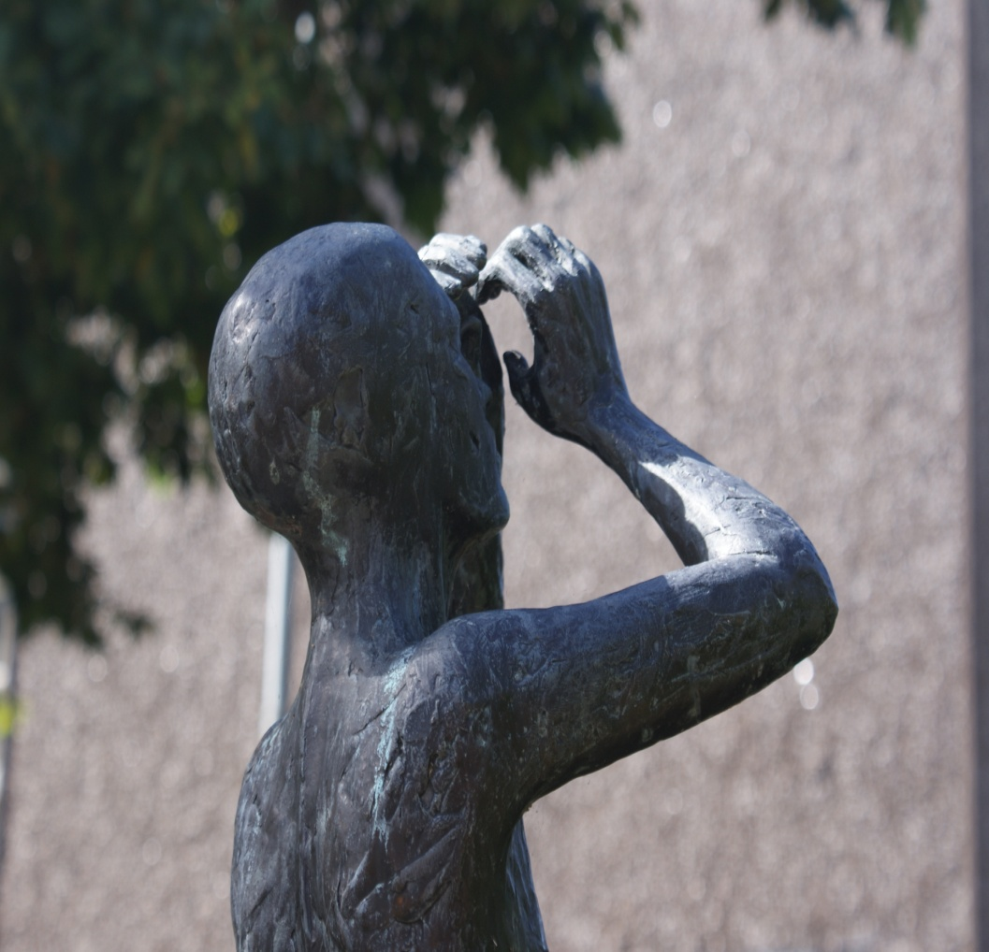
Teaching and Learning
What is the relationship between teaching and learning?
How do we know what our students know and understand?
How do we document learning?
How do these questions contribute to an understanding of teaching excellence?

